Slide 1
Profitable Opportunities in the Movie Industry
Microsoft Movie Studio

Slide 2
What to consider to be profitable in the movie industry if Microsoft opens a movie studio.
Best months:
What are the key months to release?
Best themes by month:
What are the outperforming genres based on month released?
Datasets:
TheMovieDB.org
Movie_budgets.csv
IMDB
Title.basics.csv
Key Questions

Slide 3
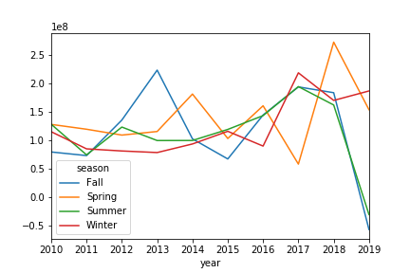
Seasons by Mean Gross Profit (GP) for Past Decade
Notes:
Source: Admissions training presentation and FAQ (July 2019)

Slide 4
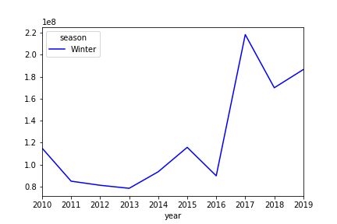
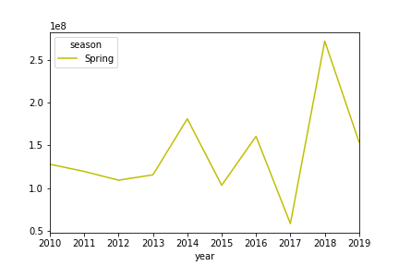
Winter & Fall Mean GP By Decade
Winter
Spring
Notes:
Source: Admissions training presentation and FAQ (July 2019)

Slide 5
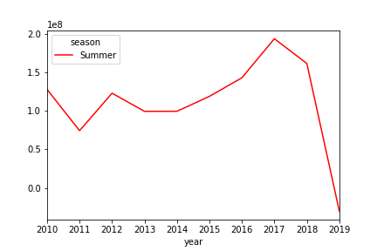
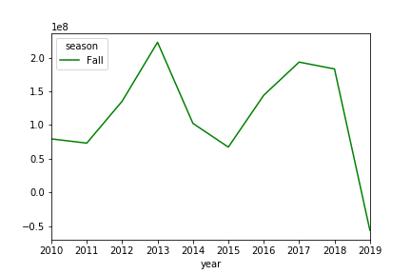
Summer & Spring Mean GP By Past Decade
Summer
Fall
Notes:
Source: Admissions training presentation and FAQ (July 2019)

Slide 6
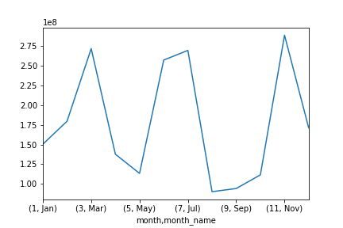
Mean Gross Profit by Month for 2017-2018
Notes:
Source: Admissions training presentation and FAQ (July 2019)

Slide 7
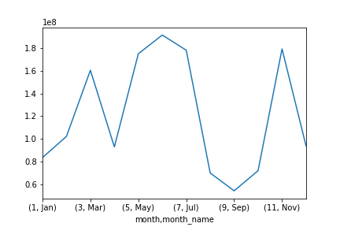
Mean Gross Profit by Month Comparison
2017-2018
10 years
Notes:
Source: Admissions training presentation and FAQ (July 2019)

Slide 8
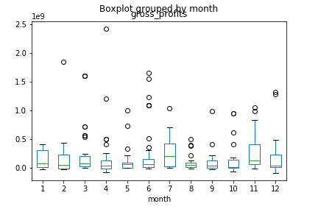
2017-2018 GP Distribution by Month
Notes:
Source: Admissions training presentation and FAQ (July 2019)

Slide 9
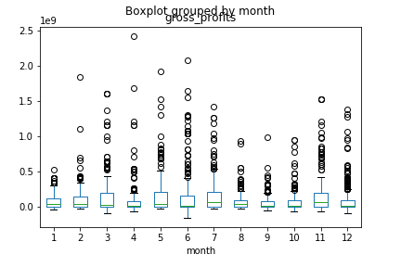
10 year GP Distribution by Month
Notes:
Source: Admissions training presentation and FAQ (July 2019)

Slide 10
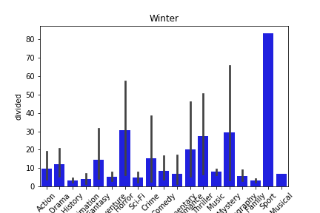
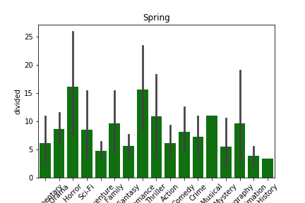
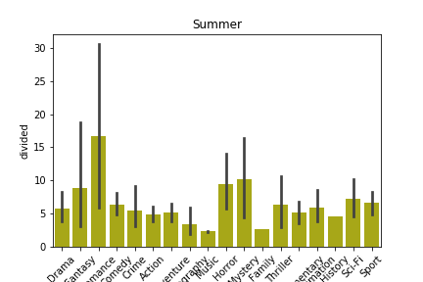
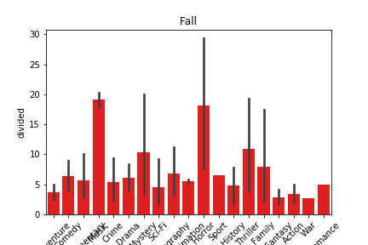
All Seasons Gross Profit from 2017-2018
Notes:
Source: Admissions training presentation and FAQ (July 2019)

Slide 11
We recommend releasing:
Romance in July
Horror in November
Recommendations & Limitations

Slide 12
Limitations by complete data
Characteristics of box office hits (outliers)
Provide expected gross profit given budget, release date, and genres
Further Research and Next Steps

Slide 13
Thank You!

